Slide 1
Release 5
Senior Design
Notes:
Taher

Slide 2
Project Background
Notes:
Taher

Slide 3
Introduction
What is our project?
To design and create a process that allows users to control hardware that captures and provides consistent high quality photos in a 360° view to be saved to Spreetail storage.
Notes:
Taher

Slide 4
Introduction
Why is this project important?
Simplify photography process
Provide consistent high quality photos
Photos will be used on Spreetail.com
Set Spreetail apart from competition through photography
Notes:
Taher

Slide 5
Introduction
How will we accomplish our goals?
Create a user friendly front-end web-application
Using React and Spreetail library components
User can enter product ItemID
View preview image from each camera
Start full 360° image capture
View and select images to be stored
Send selected photos to Spreetail storage
Notes:
Taher

Slide 6
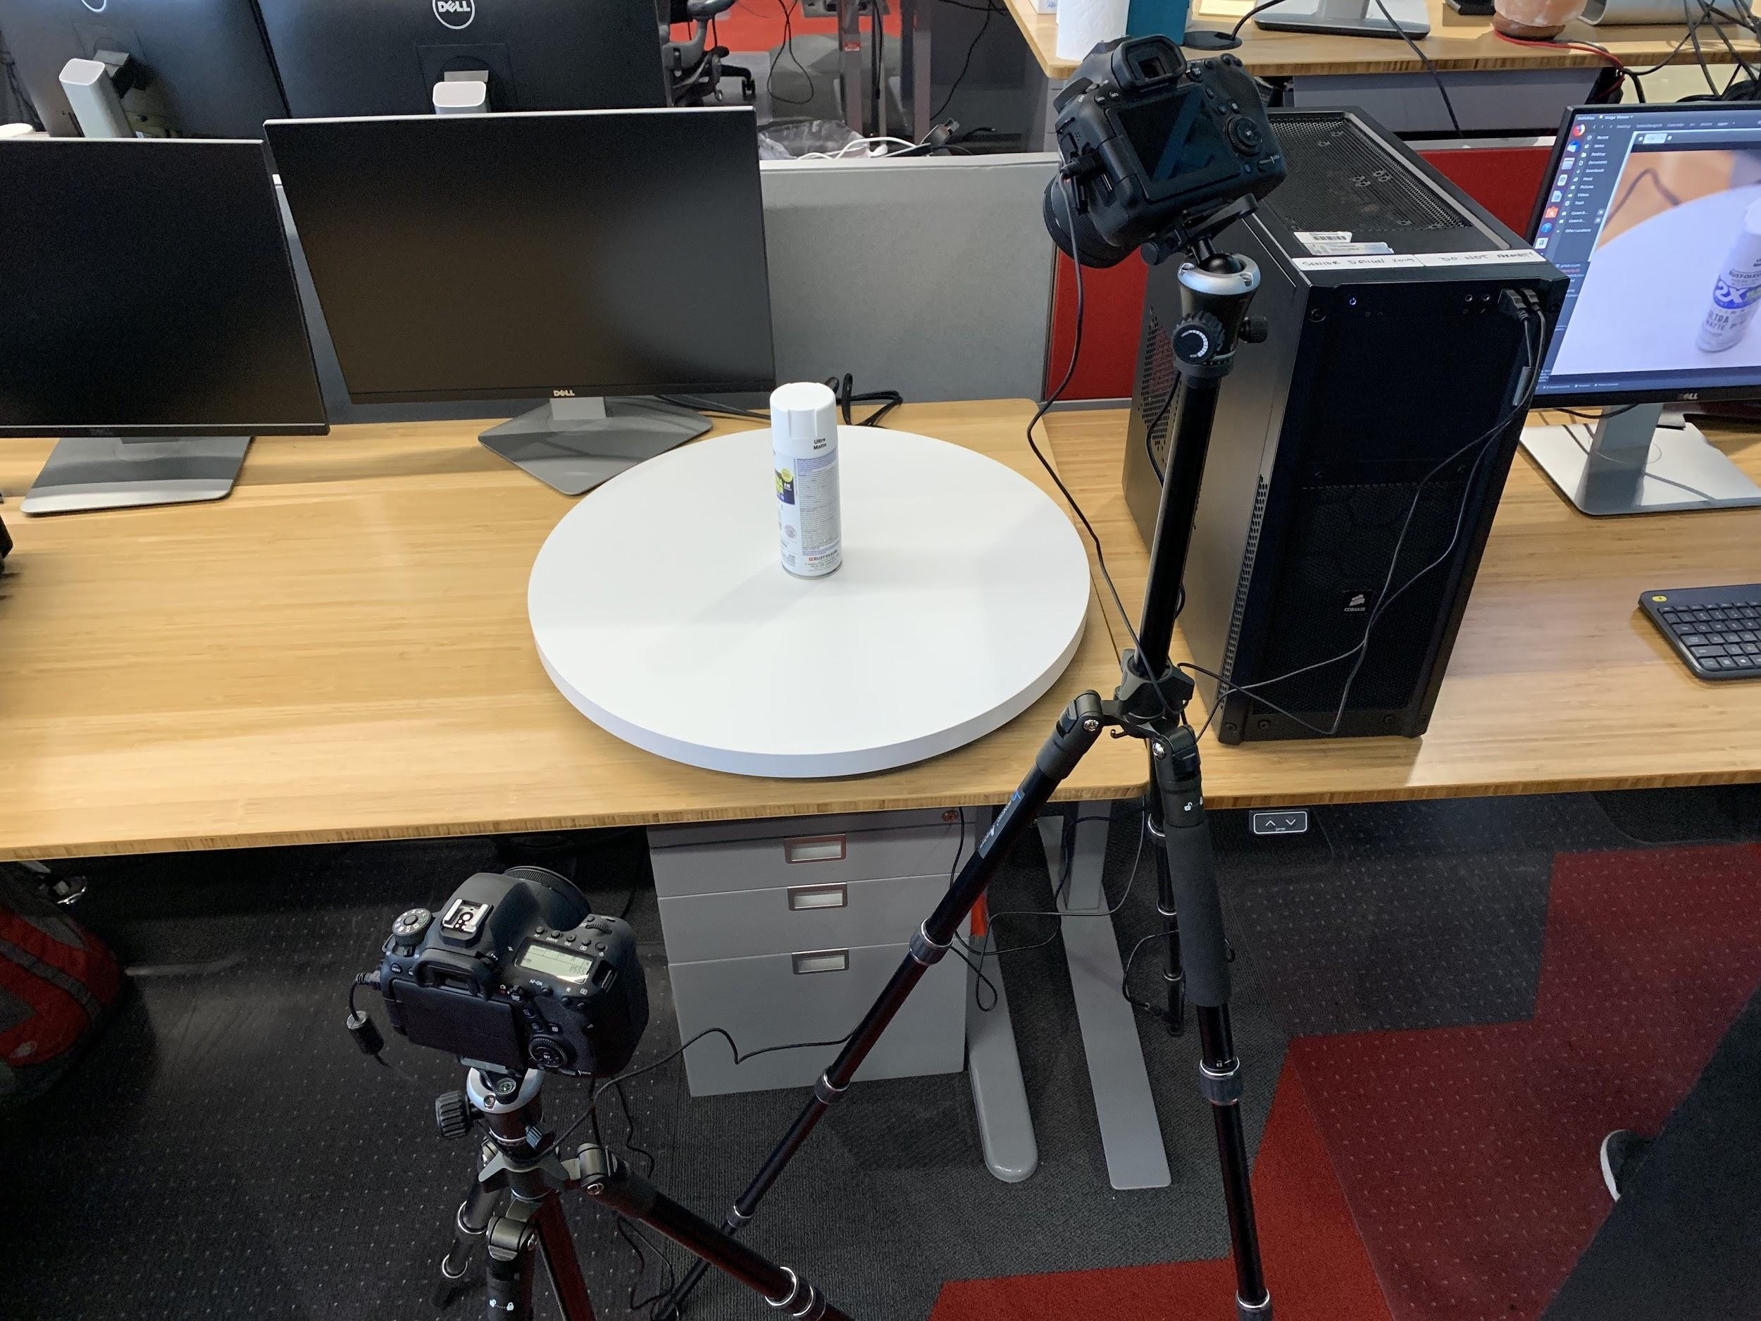
Introduction
How will we accomplish our goals?
Components for hardware setup
Two DSLR Cameras (Canon EOS 6D Mark II)
Two Tripods
Electric Turntable (Spins at ~97 sec/rotation)
Linux tower for camera control
Lighting (Provided by Spreetail, warehouse has lighting setup)
Software to control cameras via Linux tower
Notes:
Li

Slide 7
Introduction
How will we accomplish our goals?
Communication between Web-application and hardware
Azure Message Bus Service
Fast messaging between entities
Decouples application and control tower
Both sides can connect from anywhere
Allow the front end to send commands to the control tower
Provide specific commands to take/retrieve images
Notes:
Li

Slide 8
Progress
Last Release Summary
FE - Preview Page
Preview Process
Moved to Azure Service Bus
Built full hardware rig
Notes:
Li

Slide 9
Progress
Front End - Last Release
Preview Page
Applied Spreetail Design Principles
Routing between views
Service Bus Connection
Notes:
Li

Slide 10
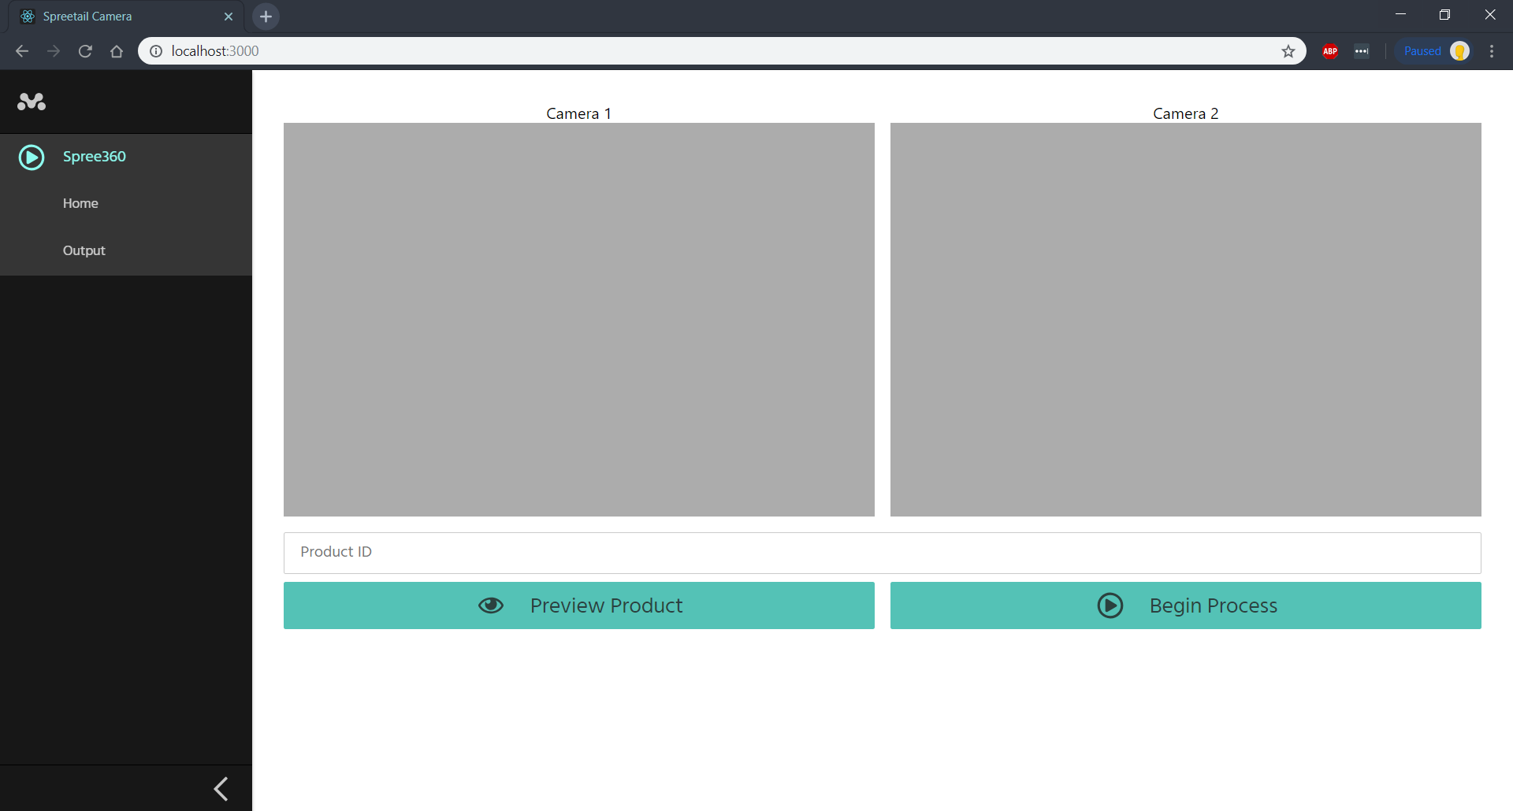
Notes:
Ant

Slide 11
Progress
Front End - This Release
Display full capture thumbnails
View larger version of images
Select images to remove
Retake Images
Progress Bar
Display Errors
Loading Spinners for both views
Disable Buttons according to task
Send images to delete from tower
Notes:
Ant

Slide 12
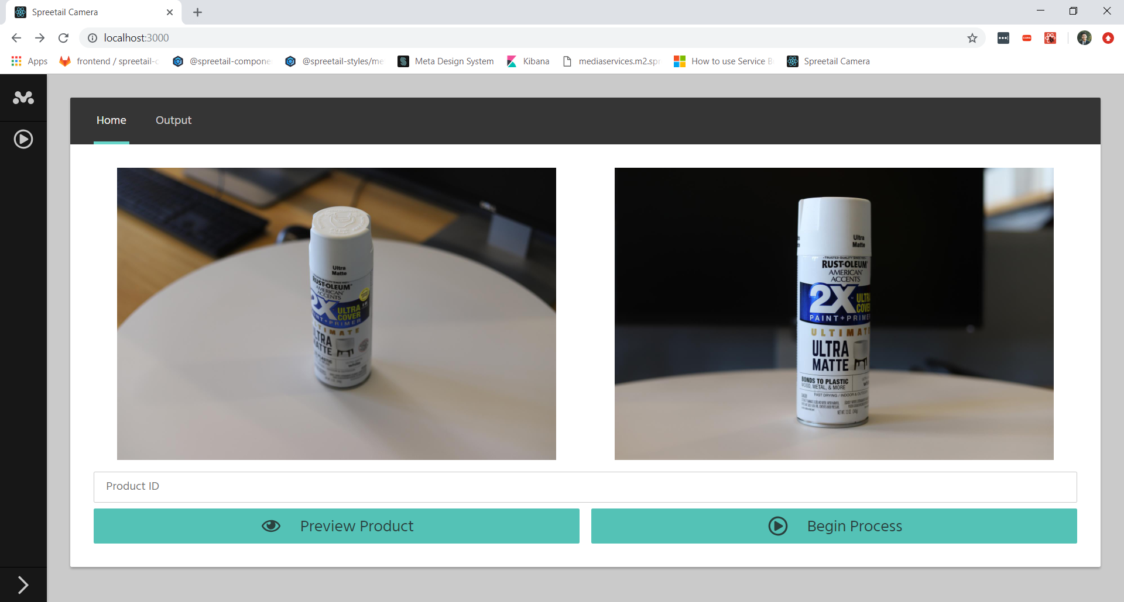
(New Preview Page Design)
Notes:
Ant

Slide 13
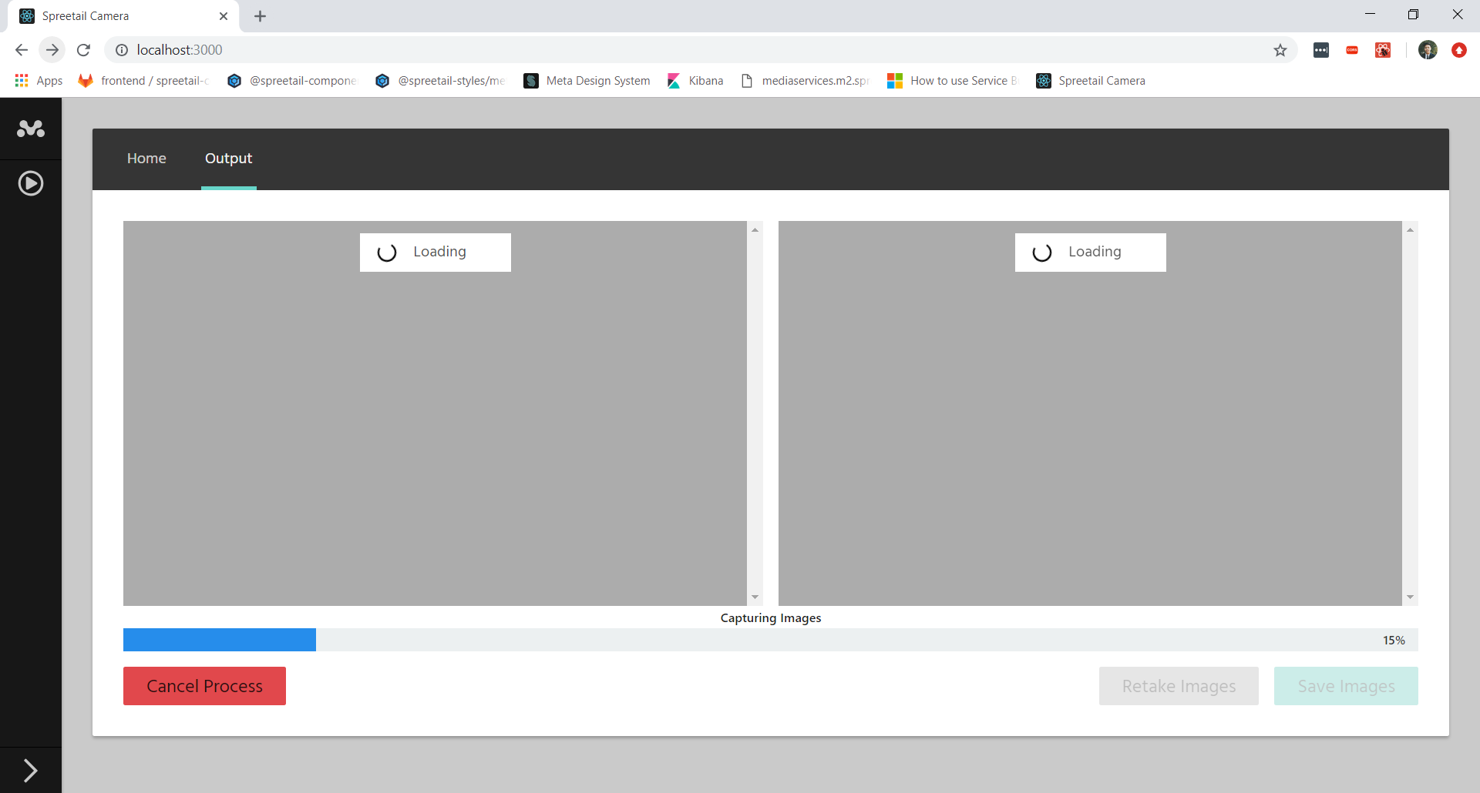
(New Output Page Design)
Notes:
Ant

Slide 14
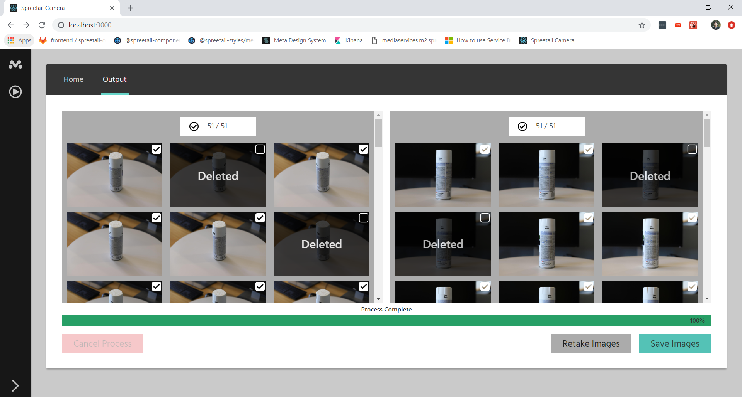
(New Output Page Design)
Notes:
Ant

Slide 15
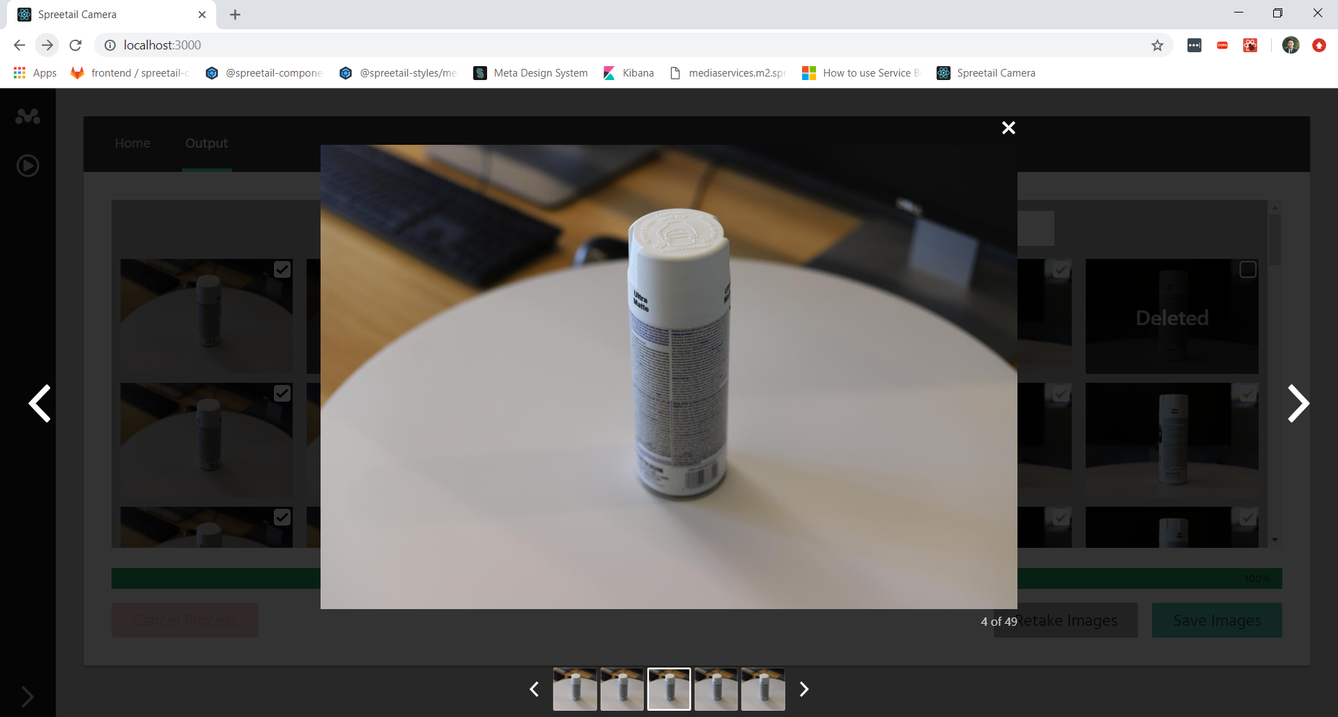
(New Output Page Design)
Notes:
Ant

Slide 16
Progress
Hardware - Last Release
Received final components
Built Full Hardware Rig
Control 2 cameras simultaneously
Unit Testing for hardware code
Notes:
Jared

Slide 17
Progress
Hardware - This Release
Integration Tests
Clearing Message Queue
Progress Updates
White Turntable
Camera Control command changes
Cancel Photo Process
Error Handling
Establish Azure Storage Connection
Notes:
Jared

Slide 18
Progress
Blockers Along the Way
Access to Spreetail Storage Service
Gained access this past week
Made connection, need to implement saving images
No User Testing
Scheduled user testing for week following Spring Break
Notes:
Jared

Slide 19
Demo

Slide 20
Release 6
What to expect
Finish Save functionality (Spreetail Storage Blob)
User Testing (Early Release 6)
Bug hunt and fixes
Code cleanup
Documentation
Potential upgrade to newer Azure Service Bus Python API
Follows new API structure created by Microsoft
Notes:
Jared

Slide 21
Questions?

